Slide 1
Introduction

Slide 2
What is information Retrieval?
Information Retrieval is finding material of an unstructured nature that satisfies an information need from within large collections. IR locates relevant documents, on the basis of user input such as keywords or example documents.
Information Retrieval System is a system it is a capable of storing, maintaining from a system and retrieving of information. This information May any of the form that is audio, vedio, text.

Slide 3
Information Retrieval System is mainly focus electronic searching and retrieving of documents.
Information Retrieval is a activity of obtaining relevant documents based on user needs from collection of retrieved documents.

Slide 4
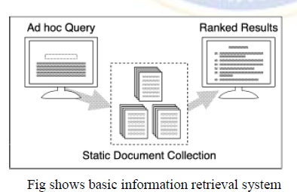

Slide 5
A static, or relatively static, document collection is indexed prior to any user query.
• A query is issued and a set of documents that are deemed relevant to the query are ranked based on their computed similarity to the query and presented to the user query.
• Information Retrieval (IR) is devoted to finding relevant documents, not finding simple matches to patterns.

Slide 6
A related problem is that of document routing or filtering. Here, the queries are static and the document collection constantly changes. An environment where corporate e-mail is routed based on predefined queries to different parts of the organization (i.e., e-mail about sales is routed to the sales department, marketing e-mail goes to marketing, etc.) is an example of an application of document routing.

Slide 7
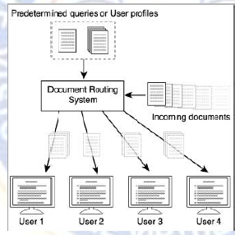

Slide 8
ISSUES IN IR
Information retrieval researchers have focused on a few key issues that remain just as important in the era of commercial web search engines working with billions of web pages as they were when tests were done in the 1960s on document collections containing about 1.5 megabytes of text. One of these issues is relevance

Slide 9
Relevance
Relevant document contains the information that a person was looking for when she submitted a query to the search engine. These factors must be taken into account when designing algorithms for comparing text and ranking documents
• UNIX produces very poor results in terms of relevance This is referred to as the vocabulary mismatch problem in information retrieval.
• Topical relevance text document is topically relevant to a query if it is on the same topic
• User relevance.The person who asked the question

Slide 10
Evaluation
The quality of a document ranking depends on how well it matches a person’s expectations, it was necessary early on to develop evaluation measures and experimental procedures for acquiring this data and using it to compare ranking algorithms.
Two of the measures used,
Precision and recall, are still popular

Slide 11
THE IMPACT OF THE WEB ON IR
The worldwide web is developed by Tim Berners Lee in 1990 at CERN to organize research documents available on the internet. It is combined idea of documents available by FTP with the idea of hypertext to link documents.
Query Operations:
Clients to the browser application to send URLs via HTTP to servers requesting a web page.
Web pages constructed using HTML or other markup language and consist of text, graphics, and sound plus embedded files.
Web search also has root in IR. IR helps users of finding information that matches their information needs.

Slide 12
A query is formulation of a user information need Keyword-based queries are popular
A sequence of single-word queries
Eg: retrieval
Boolean queries (using AND, OR, NOT)
Document = Logical conjunction of keywords
Query = Boolean expression of keywords
R(D, Q) = D →Q

Slide 13
Vector Space queries
Vector space = all the keywords encountered
<t1, t2, t3, …, tn>
Document
D = < a1, a2, a3, …, an>
ai = weight of ti in D
Query
Q = < b1, b2, b3, …, bn>
bi = weight of ti in Q
R(D,Q) = Sim(D,Q)

Slide 14
Phrase queries
Retrieve documents with a specific phrase (ordered list of contiguous words)
“Information theory”
Proximity queries
List of words with specific maximal distance constraints between terms.
Example: “dogs” and “race” within 4 words match “…dogs will begin the race…”
Full document queries
Queries should be full document

Slide 15
Retrieval System
Finding documents relevant to user queries. One way to find relevant documents on the web is to launch a web robot. Web robot is also called a wanderer, worm, walker spider etc….These software program receives a query then systematically explore the web to locate documents, evaluate their relevance and return a ranked ordered list of documents.
Selective systematic recall of logically stored information
Collect and organize information in one or more areas
Set of operations, procedures units are indexed the resulting records are stored and displayed and so can be retrieved

Slide 16
Indexing:
Indexing Processing involves Preprocessing and Storing of information into a repository.
Retrieval/Runtime process involves issuing a query, accessing the index to find the documents relevant the query.
In IR indexing is the process developing a document representation representation by an context descriptors or terms due to the documents.

Slide 17
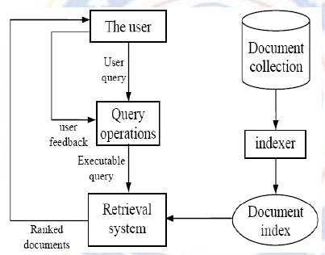
Impact of the Web on IR

Slide 18
Page 36 from Modern information retreival

